Slide 1
Unit 3 Introduction and Interacting with shell and Desktop to Linux:

Slide 2
In today’s class, we’ll discuss
SHELL
KERNEL

Slide 3
Shell
A Shell is a program that provides an interface between a user and an operating system (OS) kernel.
An OS starts a shell for each user when the user logs in or opens a terminal or console window.

Slide 4
Kernel
A kernel is a program that:
Controls all computer operations.
Coordinates all executing utilities
Ensures that executing utilities do not interfere with each other or consume all system resources.
Schedules and manages all system processes.
By interfacing with a kernel, a shell provides a way for a user to execute utilities and programs.

Slide 5
Shell
The shell sits between you and the operating system, acting as a command interpreter.
It reads your terminal input and translates the commands into actions taken by the system. The shell is analogous to command.com in DOS.
When you log into the system you are given a default shell.
When the shell starts up it reads its startup files and may set environment variables, command search paths, and command aliases, and executes any commands specified in these files.

Slide 6
Shell Program
It’s collections of executables or commands placed in a file and executed.
It provides user an option to execute a command based on some condition.
It provides conditional and control statements.(if, for, while, switch-case etc )

Slide 7
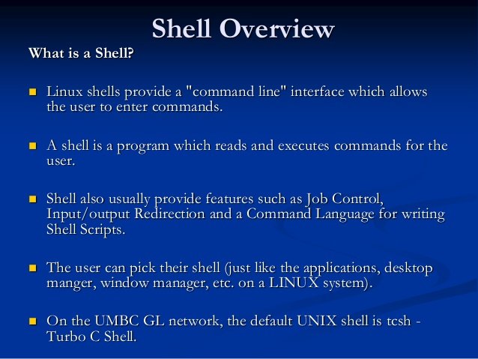

Slide 8
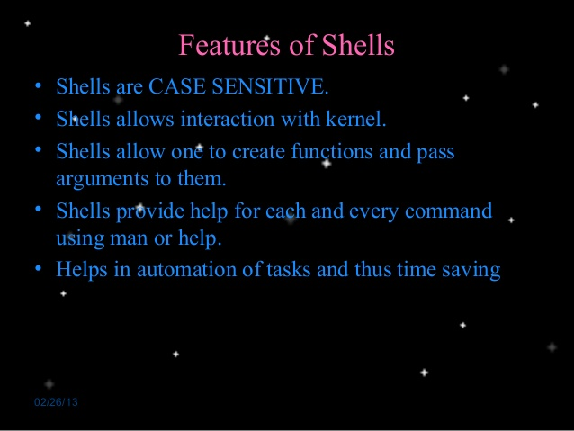

Slide 9
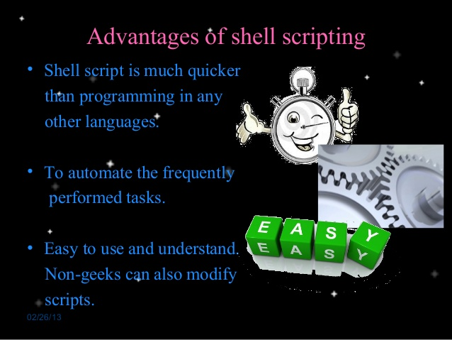

Slide 10
Types of Shell
Bourne shell (sh)
C shell (csh)
TC shell (tcsh)
Korn shell (ksh)
Bourne Again Shell (bash)

Slide 11
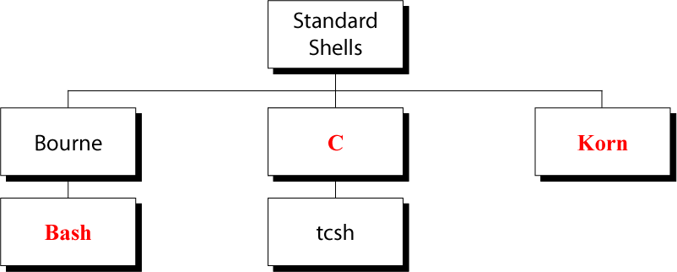
Types of Shell

Slide 12
The Bourne Shell
The Bourne shell (sh), written by Steve Bourne at AT&T Bell Labs, is the original UNIX shell. It is the preferred shell for shell programming because of its compactness and speed.
A Bourne shell drawback is that it lacks features for interactive use, such as the ability to recall previous commands (history). The Bourne shell also lacks built-in arithmetic and logical expression handling.

Slide 13
The Bourne Shell
The Bourne shell is the Solaris OS default shell. It is the standard shell for Solaris system administration scripts.
For the Bourne shell the:
Command full-path name is /bin/sh and /sbin/sh.
Non-root user default prompt is $.
Root user default prompt is #.

Slide 14
The C Shell
The C shell (csh):
Is a UNIX enhancement written by Bill Joy at the University of California at Berkeley.
Incorporated features for interactive use, such as aliases and command history.
Includes convenient programming features, such as built-in arithmetic and a C-like expression syntax.

Slide 15
The C Shell
For the C shell the:
Command full-path name is /bin/csh.
Non-root user default prompt is hostname %.
Root user default prompt is hostname #.

Slide 16
The Korn Shell
The Korn shell (ksh):
Was written by David Korn at AT&T Bell Labs
Is a superset of the Bourne shell.
Supports everything in the Bourne shell.
Has interactive features comparable to those in the C shell.
Includes convenient programming features like built-in arithmetic and C-like arrays, functions, and string-manipulation facilities.
Is faster than the C shell.
Runs scripts written for the Bourne shell.

Slide 17
The Korn Shell
For the Korn shell the:
Command full-path name is /bin/ksh.
Non-root user default prompt is $.
Root user default prompt is #.

Slide 18
The GNU Bourne-Again Shell
The GNU Bourne-Again shell (bash):
Is compatible to the Bourne shell.
Incorporates useful features from the Korn and C shells.
Has arrow keys that are automatically mapped for command recall and editing.

Slide 19
The GNU Bourne-Again Shell
For the GNU Bourne-Again shell the:
Command full-path name is /bin/bash.
Default prompt for a non-root user is bash-x.xx$. (Where x.xx indicates the shell version number. For example, bash-3.50$)
Root user default prompt is bash-x.xx#. (Where x.xx indicates the shell version number. For example, bash-3.50$#)
zsh (Z Shell) The Z Shell is an improved version of the bash shell.

Slide 20
Linux Command-Line Interface
Libraries Libraries are pre-written code “pieces” that application programmers use in their programs.
Utilities maintaining the file system, editing text files, managing running processes, and installing new software packages.
User Interface command-line interface (CLI) and a graphical user interface (GUI).

Slide 21

Linux Command-Line Interface..

Slide 22
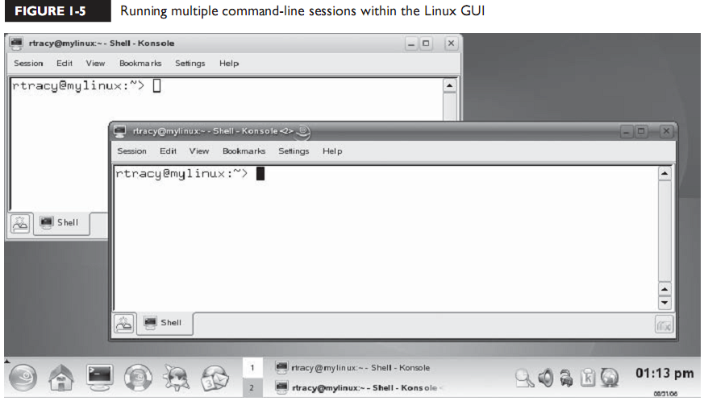
Running multiple command-line sessions within LINUX GUI

Slide 23
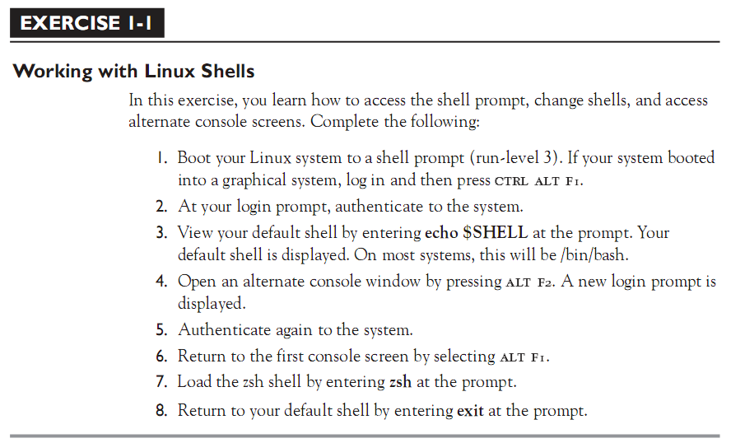

Slide 24
Commonly Used CLI Commands and Utilities
/ : denote root directory
./ : denote current directory
PATH :
■ halt This command shuts down the operating system, but can only be run by the root user.
■ reboot This command shuts down and restarts the operating system. It also can only be run by root.

Slide 25
Commonly Used CLI Commands
man: is help command. Ex: man ls
Press q to quit
/xyz to search string in man page
pwd: Display current Directory

Slide 26
cd: Changing Directories
cd # go to home directory
cd ~/papers # go to /home/user/papers
cd ~fred # go to /home/fred
cd dir # go to directory (relative)
cd /dir1/dir2/dir3... # go to directory (absolute)
cd .. # go to last directory you were in

Slide 27
cp: copy file
cp file1 file2 # copy file1 to file2
cp file1 directory # copy file1 into directory
cp file1 file2 file3 ... directory # copy files into directory
cp -R dir1 dir2/ # copy dir1 into dir2 including subdirectries

Slide 28
Commonly Used CLI Commands
date - Shows current date
date Sat Aug 31 17:18:53 BST 2002
logout - Closes the current shell. Also try ``exit''.

Slide 29
rm - Delete (remove) files
rm file1 # delete a file (use -i to ask whether sure)
rm -r dir1 # delete a directory and everything in it (CARE!)
rm -rf dir1 # like above, but don't ask if we have a -i alias

Slide 30
Commands…
■ su (switch user)
This command switches the current user to a new user account.
This command is most frequently used to switch to the superuser root account.
In fact, if you don’t supply a username, this utility assumes that you want to change to the root account.
If you enter su -, then you will switch to the root user account and have all of root’s environment variables applied.

Slide 31
Commands…
■ env This command displays the environment variables for the currently logged-in user.
■ echo This command is used to echo a line of text on the screen. It’s frequently used to display environment variables.
Ex: echo $PATH

Slide 32
Commands…
■ top This command is a very useful command that displays a list of all
applications and processes currently running on the system.
■ which This command is used to display the full path to a shell command or utility.
Ex: which ls
It display: /bin/ls

Slide 33
Commands…
■ whoami This command displays the username of the currently logged-in user.
■ netstat This command displays the status of the network, including current connections, routing tables, etc.
■ route This command is used to view or manipulate the system’s routing table.
■ ifconfig This command is used to manage network boards installed in the system. It can be used to display or modify your network board configuration parameters.

Slide 34
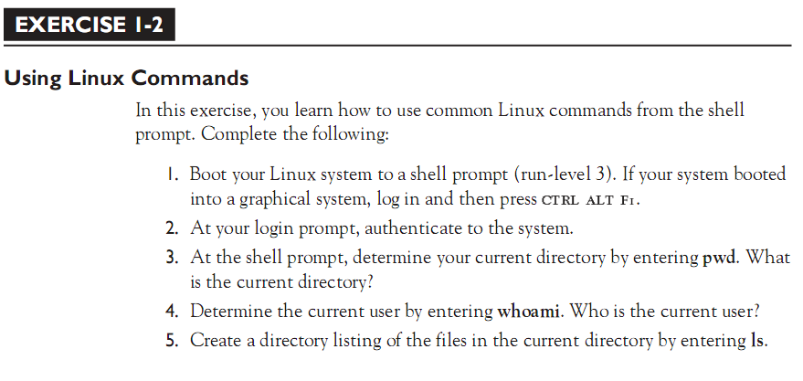
Exercise questions

Slide 35
Linux Graphical User Interface
XFree86 project developed a free windows system that provides a GUI on the Linux operating system. Using X Windows along with a window manager and a desktop environment (such as GNOME or KDE), users can interact with the Linux kernel using a mouse instead of the keyboard.

Slide 36
Linux Commands
Command <Options> <Arguments>
Multiple commands separated by ; can be executed one after the other

Slide 37
Help Facilities for Commands
Linux Commands
To understand the working of the command and possible options use (man command)
Using the GNU Info System (info, info command)
Listing a Description of a Program (whatis command)
Many tools have a long−style option, `−−help', that outputs usage information about the tool, including the options and arguments the tool takes. Ex: whoami --help

Slide 38
Linux File Management and Viewing
Linux Commands
ls List contents of a directory.
Ex: ls, ls –l , ls –al, ls –ld, ls –R
(-rwxrwxr-x 1 juan juan 0 Sep 26 12:25 foo )
|more will list page wise
mkdir Make a directory.
Ex: mkdir <directory name> : Makes a directory
Ex mkdir –p /www/chache/var/log will create all the directories starting from www.
mv Move or rename a file or directory.
Ex: mv <source> <destination>

Slide 39
Linux File Management and Viewing
Linux Commands
cat View a file
Ex: cat filename
cmp Compare two files.
cut Remove sections from each line of files.
diff Show the differences between files.
Ex: diff file1 file2 : Find differences between file1 & file2.
echo Display a line of text.

Slide 40
Linux File Management and Viewing
Linux Commands
grep List all files with the specified expression. (grep pattern <filename/directorypath>) Ex: ls –l |grep sidbi : List all lines with a sidbi in them.
Ex: grep " R " : Search for R with a space on each side
sleep Delay for a specified amount of time.
sort Sort a file alphabetically.
uniq Remove duplicate lines from a sorted file.
wc Count lines, words, characters in a file. (wc –c/w/l <filename>).

Slide 41
Example:
#print date and time - today.sh
echo "Today is:"
date
Save it as today.sh
Run:
sh today.sh
Notes:
41

Slide 42
Example:
#sample.sh
#!/bin/sh
# assign a value:
a="hello world"
# now print the content of "a":
echo "A is:"
echo $a
Notes:
42

Slide 43
Example:
#ex-2 grep word in a file - grep_ex.sh
echo "Enter the search string:"
read string
echo "Enter the file name:"
read filename
grep -n "$string" $filename
Notes:
43

Slide 44
Example:
If statement
Type 1:
if condition is true
then
do this
fi
Type 2:
if condition is true
then
do this
else
do that
fi
Notes:
44

Slide 45
#if stmt - if_ex.sh
echo "Enter the search string:"
read string
echo "Enter the file name:"
read filename
grep -n "$string" $filename
# $? gives exit status of last command
if [ $? -eq 0 ]
then
echo " Yes,the word present in the file"
else
echo "No,word not present"
fi
Notes:
45

Slide 46
o/p :
[oss@pc021698 ~]$ sh if_ex.sh
Enter the search string:
date
Enter the file name:
today.sh
2:date
Yes,the word present in the file
o/p:
[oss@pc021698 ~]$ sh if_ex.sh
Enter the search string:
year
Enter the file name:
today.sh
No,word not present
Notes:
46

Slide 47
Passing values from command line:
$0 - Program name
$1 - First argument
$2 - Second arg.
$# - No.of arg
$? - Exit status
Notes:
47

Slide 48
#print date and time and cmd arg - today_1.sh
echo "Today is:"
date
echo “No .of arg:”$#
echo “Program name:”$0
o/p:
[oss@pc021698 ~]$ sh today_1.sh
Today is:
Fri Mar 7 00:28:27 IST 2008
“No .of arg:”0
“Program name:”today_1.sh
Notes:
48

Slide 49
#grep using cmd line -grep_ex2.sh
echo "Entered search string is:"$1
echo "Entered file name :"$2
grep -n "$1" $2
# $? gives exit status of last command
if [ $? -eq 0 ]
then
echo " Yes,the word present in the file"
else
echo "No,word not present"
fi
Notes:
49

Slide 50
o/p:
[oss@pc021698 ~]$ sh grep_ex2.sh date today.sh
Entered search string is:date
Entered file name :today.sh
2:date
Yes,the word present in the file
Notes:
50

Slide 51
#simple for loop
for i in 1 2 3
do
echo "==>$i"
done
#for loop - for_ex.sh
for file in *.
do
echo “Hi”
done
#simple for loop-3
for (( j = 1 ; j <= 5; j++ ))
do
echo -n "$j "
done
Notes:
51

Slide 52
#print files with extension .c
for file in *.c
do
echo "Filename==>$file"
#place any no.of cmds
cp $file /home/oss/cprogs
done
Notes:
52

Slide 53
while loop – syntax
while [ condition ]
do
code block;
done
Notes:
53

Slide 54
#while_ex.sh
verify="n"
while [ "$verify" != y ]
do
echo "Enter option: "
read option
echo "You entered $option. Is this correct? (y/n)"
read verify
done
Notes:
54

Slide 55
The Metacharacters
*
?
[ ]
'
"
\
$
;
&
( )
|
^
< >
new-line space tab

Slide 56
SUBSTITUTION
The shell performs substitution when it encounters an expression that contains one or more special characters.

Slide 57
Example
Here, the printing value of the variable is substituted by its value.
Same time, "\n" is substituted by a new line −
a=10
echo -e "Value of a is $a \n“
You will receive the following result. Here the -e option enables the interpretation of backslash escapes.
Value of a is
10
Following is the result without -e option −
Value of a is 10\n

Slide 58
Sr.No. | Escape & Description
1 | \\ - backslash
2 | \a - alert (BEL)
3 | \b – backspace
4 | \c - suppress trailing newline
5 | \f - form feed
6 | \n - new line
7 | \r - carriage return
8 | \t - horizontal tab
9 | \v - vertical tab

Slide 59
Command Substitution
Command substitution is the mechanism by which the shell performs a given set of commands and then substitutes their output in the place of the commands.
Syntax
The command substitution is performed when a command is given as
`command`
When performing the command substitution make sure that you use the backquote, not the single quote character.

Slide 60
#!/bin/sh
DATE=`date`
echo "Date is $DATE"
USERS=`who | wc -l`
echo "Logged in user are $USERS"
UP=`date ; uptime`
echo "Uptime is $UP"
Date is Tue Aug 4 03:59:57 GMT 2020
Logged in user are 1
Uptime is Tue Aug 4 03:59:57 GMT 2020
03:59:57 up 20 days, 14:03, 1 user, load avg: 0.13, 0.07, 0.15

Slide 61
Variable Substitution
Variable substitution enables the shell programmer to manipulate the value of a variable based on its state.
Sr.No. | Form & Description
1 | ${var} - Substitute the value of var.
2 | ${var:-word} - If var is null or unset, word is substituted for var. The value of vardoes not change.
3 | ${var:=word} - If var is null or unset, var is set to the value of word.
4 | ${var:?message} - If var is null or unset, message is printed to standard error. This checks that variables are set correctly.
5 | ${var:+word} - If var is set, word is substituted for var. The value of var does not change.

Slide 62
Following is the example to show various states of the above substitution −
#!/bin/sh
echo ${var:-"Variable is not set"}
echo "1 - Value of var is ${var}"
echo ${var:="Variable is not set"}
echo "2 - Value of var is ${var}"
unset var
echo ${var:+"This is default value"}
echo "3 - Value of var is $var" var="Prefix"
echo ${var:+"This is default value"}
echo "4 - Value of var is $var"
echo ${var:?"Print this message"}
echo "5 - Value of var is ${var}“

Slide 63
Upon execution, you will receive the following result −
Variable is not set
1 - Value of var is
Variable is not set
2 - Value of var is
Variable is not set
3 - Value of var is
This is default value
4 - Value of var is Prefix
Prefix
5 - Value of var is Prefix

Slide 64
USING SHELL VARIABLES
A variable is a character string to which we assign a value.
The value assigned could be a number, text, filename, device, or any other type of data.
A variable is nothing more than a pointer to the actual data.
The shell enables you to create, assign, and delete variables.

Slide 65
Variable Names
The name of a variable can contain
Only letters (a to z or A to Z),
Numbers (0 to 9) or
The underscore character ( _).

Slide 66
By convention, Linux shell variables will have their names in UPPERCASE.
The following examples are valid variable names −
_ALI
TOKEN_A
VAR_1
VAR_2
Following are the examples of invalid variable names −
2_VAR
-VARIABLE
VAR1-VAR2
VAR_A!
The reason you cannot use other characters such as !, *, or - is that these characters have a special meaning for the shell.

Slide 67
Defining Variables
Variables are defined as follows −
variable_name=variable_value
For example −
NAME="Zara Ali"
The above example defines the variable NAME and assigns the value "Zara Ali" to it. Variables of this type are called scalar variables.
A scalar variable can hold only one value at a time.
Shell enables you to store any value you want in a variable. For example −
VAR1="Zara Ali"
VAR2=100

Slide 68
Accessing Values
To access the value stored in a variable, prefix its name with the dollar sign ($) −
For example, the following script will access the value of defined variable NAME and print it on STDOUT −
#!/bin/sh
NAME="Zara Ali"
echo $NAME
The above script will produce the following value −
Zara Ali

Slide 69
Read-only Variables
Shell provides a way to mark variables as read-only by using the read-only command.
After a variable is marked read-only, its value cannot be changed.
For example, the following script generates an error while trying to change the value of NAME −
#!/bin/sh
NAME="Zara Ali"
readonly NAME
NAME="Qadiri“
The above script will generate the following result −
/bin/sh: NAME: This variable is read only.

Slide 70
Unsetting Variables
Unsetting or deleting a variable directs the shell to remove the variable from the list of variables that it tracks.
Once you unset a variable, you cannot access the stored value in the variable.

Slide 71
Following is the syntax to unset a defined variable using the unset command −
unset variable_name
The above command unsets the value of a defined variable. Here is a simple example that demonstrates how the command works −
#!/bin/sh
NAME="Zara Ali"
unset NAME
echo $NAME
The above example does not print anything. You cannot use the unset command to unset variables that are marked readonly.

Slide 72
Variable Types
When a shell is running, three main types of variables are present −
Local Variables
Environment Variables
Shell Variables

Slide 73
grep command in Unix/Linux
The grep filter searches a file for a particular pattern of characters, and displays all lines that contain that pattern.
The pattern that is searched in the file is referred to as the regular expression (grep stands for globally search for regular expression and print out).

Slide 74
Syntax:
grep [options] pattern [files]
Options Description
-c : This prints only a count of the lines that match a pattern
-h : Display the matched lines, but do not display the filenames.
-i : Ignores, case for matching
-l : Displays list of a filenames only.
-n : Display the matched lines and their line numbers.
-v : This prints out all the lines that do not matches the pattern
-e exp : Specifies expression with this option. Can use multiple times.
-f file : Takes patterns from file, one per line.
-E : Treats pattern as an extended regular expression (ERE)
-w : Match whole word
-o : Print only the matched parts of a matching line, with each such part on a separate output line.

Slide 75
Consider the below file as an input. $cat > geekfile.txt unix is great os. unix is opensource. unix is free os. learn operating system. Unix linux which one you choose. uNix is easy to learn.unix is a multiuser os.Learn unix . unix is a powerful OS.

Slide 76
Case insensitive search : The -i option enables to search for a string case insensitively in the give file. It matches the words like “UNIX”, “Unix”, “unix”.
$grep -i “EAR" geekfile.txt
Output:
unix is great os. unix is opensource. Ear unix is free os. Unix linux which one you choose.
uNix is easy to learn.unix is a multiuser os.Learn unix .unix is a powerful OS.

Slide 77
Displaying the count of number of matches :
We can find the number of lines that matches the given string/pattern
$grep -c "unix" geekfile.txt
Output:
2

Slide 78
Display the file names that matches the pattern : We can just display the files that contains the given string/pattern.
$grep -l "unix" *
or
$grep -l "unix" f1.txt f2.txt f3.xt f4.txt geekfile.txt

Slide 79
Checking for the whole words in a file : By default, grep matches the given string/pattern even if it found as a substring in a file. The -w option to grep makes it match only the whole words.
$ grep -w "unix" geekfile.txt
Output:
unix is great os. unix is opensource. unix is free os. uNix is easy to learn.unix is a multiuser os.Learn unix .unix is a powerful.

Slide 80
Displaying only the matched pattern : By default, grep displays the entire line which has the matched string. We can make the grep to display only the matched string by using the -o option.
$ grep -o "unix" geekfile.txt
Output:
unix
unix
unix
unix
unix
unix

Slide 81
Show line number while displaying the output using grep -n : To show the line number of file with the line matched.
$ grep -n "unix" geekfile.txt
Output:
1:unix is great os. unix is opensource. unix is free os.
4:uNix is easy to learn.unix is a multiuser os.Learn unix .unix is a powerful.

Slide 82
Inverting the pattern match : You can display the lines that are not matched with the specified search sting pattern using the -v option.
$ grep -v "unix" geekfile.txt
Output:
learn operating system.
Unix linux which one you choose.

Slide 83
Matching the lines that start with a string : The ^ regular expression pattern specifies the start of a line. This can be used in grep to match the lines which start with the given string or pattern.
$ grep "^unix" geekfile.txt
Output:
unix is great os. unix is opensource. unix is free os.
9. Matching the lines that end with a string : The $ regular expression pattern specifies the end of a line. This can be used in grep to match the lines which end with the given string or pattern.
$ grep "os$" geekfile.txt

Slide 84
Specifies expression with -e option. Can use multiple times :
$grep –e "Agarwal" –e "Aggarwal" –e "Agrawal" geekfile.txt
-f file option Takes patterns from file, one per line.
$cat pattern.txt
Agarwal
Aggarwal
Agrawal
$grep –f pattern.txt geekfile.txt

Slide 85
SED
SED command in UNIX is stands for stream editor and it can perform lot’s of function on file like, searching, find and replace, insertion or deletion.
Though most common use of SED command in UNIX is for substitution or for find and replace.
By using SED you can edit files even without opening it, which is much quicker way to find and replace something in file, than first opening that file in VI Editor and then changing it.

Slide 86
SED
SED is a powerful text stream editor. Can do insertion, deletion, search and replace(substitution).
SED command in unix supports regular expression which allows it perform complex pattern matching.

Slide 87
Consider the below text file as an input.
$cat > geekfile.txt
unix is great os. unix is opensource. unix is free os.
learn operating system.
unix linux which one you choose.
unix is easy to learn. unix is a multiuser os.Learn unix .unix is a powerful.

Slide 88
Replacing or substituting string : Sed command is mostly used to replace the text in a file. The below simple sed command replaces the word “unix” with “linux” in the file.
$sed 's/unix/linux/' geekfile.txt
Output :
linux is great os. unix is opensource. unix is free os.
learn operating system.
linux linux which one you choose.
linux is easy to learn.unix is a multiuser os.Learn unix .unix is a powerful.
Here the “s” specifies the substitution operation. The “/” are delimiters. The “unix” is the search pattern and the “linux” is the replacement string.
By default, the sed command replaces the first occurrence of the pattern in each line and it won’t replace the second, third…occurrence in the line.

Slide 89
Replacing the nth occurrence of a pattern in a line : Use the /1, /2 etc flags to replace the first, second occurrence of a pattern in a line. The below command replaces the second occurrence of the word “unix” with “linux” in a line.
$sed 's/unix/linux/2' geekfile.txt
Output:
unix is great os. linux is opensource. unix is free os.
learn operating system.
unix linux which one you choose.
unix is easy to learn.linux is a multiuser os.Learn unix .unix is a powerful.

Slide 90
Replacing all the occurrence of the pattern in a line : The substitute flag /g (global replacement) specifies the sed command to replace all the occurrences of the string in the line.
$sed –n ‘5 s/unix/linux/3' geekfile.txt
Output :
linux is great os. linux is opensource. linux is free os.
learn operating system.
linux linux which one you choose.
linux is easy to learn.linux is a multiuser os.Learn linux .linux is a powerful.

Slide 91
Deleting lines from a particular file : SED command can also be used for deleting lines from a particular file. SED command is used for performing deletion operation without even opening the file.
Examples:
1. To Delete a particular line say n in this example
Syntax: $ sed 'nd' filename.txt
Example: $ sed '5d' filename.txt
2. To Delete a last line
Syntax: $ sed '$d' filename.txt
3. To Delete line from range x to y
Syntax: $ sed 'x,yd' filename.txt
Example: $ sed '3,6d' filename.txt

Slide 92
To Delete from nth to last line
Syntax: $ sed 'nth,$d' filename.txt
Example: $ sed '12,$d' filename.txt
To Delete pattern matching line
Syntax: $ sed '/pattern/d' filename.txt
Example: $ sed '/abc/d' filename.txt

Slide 93
AWK
AWK is an interpreted programming language. It is very powerful and specially designed for text processing.
Its name is derived from the family names of its authors −
Alfred Aho, Peter Weinberger, and Brian Kernighan.
The version of AWK that GNU/Linux distributes is written and maintained by the Free Software Foundation (FSF); it is often referred to as GNU AWK.

Slide 94
Types of AWK
Following are the variants of AWK −
AWK − Original AWK from AT & T Laboratory.
NAWK − Newer and improved version of AWK from AT & T Laboratory.
GAWK − It is GNU AWK. All GNU/Linux distributions ship GAWK. It is fully compatible with AWK and NAWK.

Slide 95
Typical Uses of AWK
MANY tasks can be done with AWK. Listed below are just a few of them −
Text processing,
Producing formatted text reports,
Performing arithmetic operations,
Performing string operations, and many more.

Slide 96
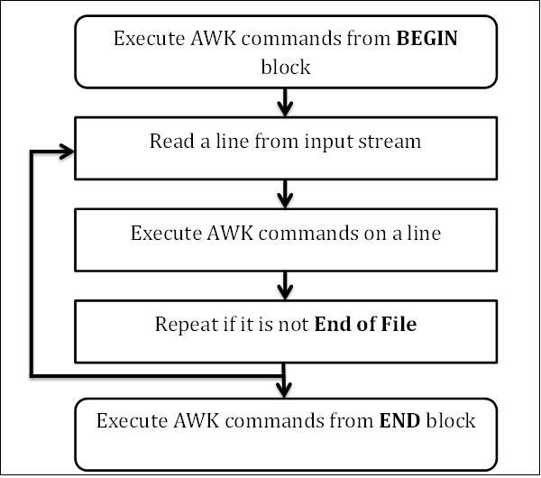
Workflow of AWK
To become an expert AWK programmer, you need to know its internals. AWK follows a simple workflow − Read, Execute, and Repeat.

Slide 97
Read
AWK reads a line from the input stream (file, pipe, or stdin) and stores it in memory.
Execute
All AWK commands are applied sequentially on the input. By default AWK execute commands on every line. We can restrict this by providing patterns.
Repeat
This process repeats until the file reaches its end.

Slide 98
Program Structure
BEGIN block
The syntax of the BEGIN block is as follows −
Syntax
BEGIN {awk-commands}
The BEGIN block gets executed at program start-up. It executes only once. This is good place to initialize variables. BEGIN is an AWK keyword and hence it must be in upper-case. Please note that this block is optional.

Slide 99
Program Structure
Body Block
The syntax of the body block is as follows −
Syntax
/pattern/ {awk-commands}
The body block applies AWK commands on every input line. By default, AWK executes commands on every line. We can restrict this by providing patterns. Note that there are no keywords for the Body block.

Slide 100
Program Structure
END Block
The syntax of the END block is as follows −
Syntax
END {awk-commands}
The END block executes at the end of the program. END is an AWK keyword and hence it must be in upper-case. Please note that this block is optional.

Slide 101
Let us create a file marks.txt which contains the serial number, name of the student, subject name, and number of marks obtained.
Amit Physics 80
Rahul Maths 90
Shyam Biology 87
Shubham English 85
Hari History 89

Slide 102
Let us now display the file contents with header by using AWK script.
$ awk '{print}' marks.txt
$ awk '{print $3 "\t" $4}' marks.txt

Slide 103
Example
$ awk 'BEGIN{printf "Sr No\tName\tSub\tMarks\n"} {print}' marks.txt
When this code is executed, it produces the following result −
Output
Sr No Name Sub Marks
Amit Physics 80
Rahul Maths 90
Shyam Biology 87
Shubham English 85
Hari History 89

Slide 104
THANK YOU

